Slide 1

WINNERS
Kavana S R Shraddha R L Anci Muktha Nayak

Slide 2



Travel Connect
Seamless Journeys
Welcome to our comprehensive travel platform designed to simplify your journey from start to finish.

Slide 3
Problem solving statement
Problem solving statement is How can we create a travel plotform and How can book a ticket for flight,bus,car and homestay,food facility.

Slide 4
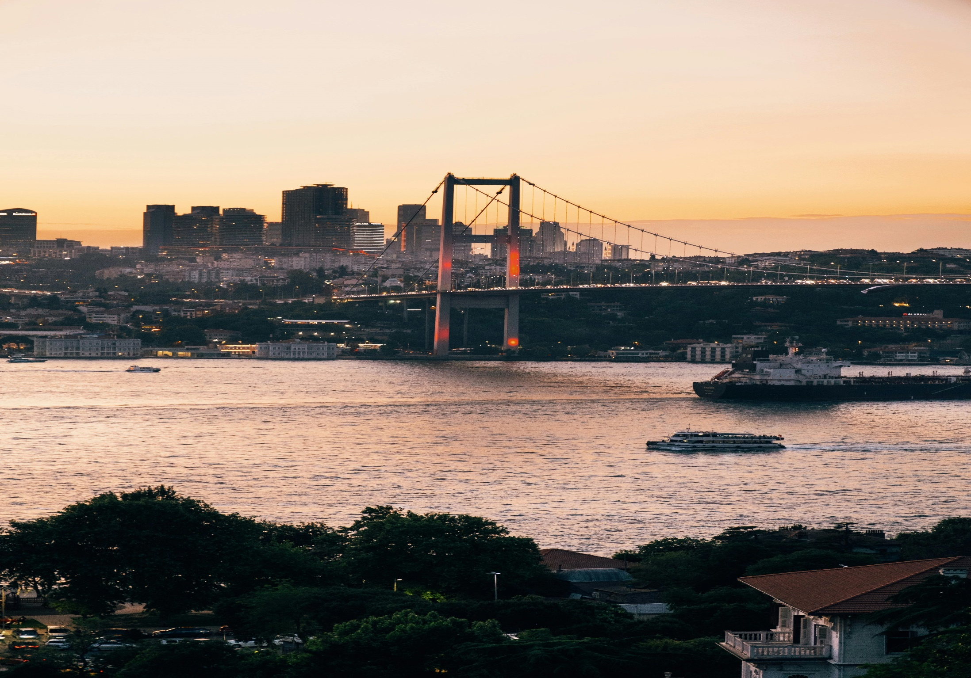
Click on the image to get a website

Slide 5

Streamlined Booking
Enjoy a seamless booking experience for flights, ground transportation, accommodations, and dining.
Comprehensive Travel
Solutions
Personalized Itineraries
Create customized itineraries based on your interests, budget, and travel style.
Secure and Reliable
Rest assured knowing our platform is secure and offers 24/7 customer support.
Back to Agenda

Slide 6


Global Network
Access a vast network of airlines and find the best flight options for your needs.
Flight Booking and Reservations
Competitive Prices
Enjoy transparent pricing and compare fares from multiple airlines.
Flexible Options
Choose from economy, premium, and business class options, depending on your preference.

Slide 7

Airport Transfers
Pre-book convenient airport transfers for a smooth arrival and departure.
Ground Transportation Options
Rental Cars
Explore destinations at your own pace with our reliable car rental services.
Public Transportation
Access local bus and train schedules for easy and affordable travel.

Slide 8

Hotels
Find a wide range of hotel options, from budget-friendly to luxurious.
Accommodations and Homestays
Homestays
Immerse yourself in local culture with authentic homestays.
Villas and Apartments
Enjoy spacious and private accommodations for your group.

Slide 9
Culinary Experiences and Dining
Local Food Tours
Sample authentic dishes and learn about local culinary traditions.
Restaurant Reservations
Secure reservations at top-rated restaurants in your destination.
Private Chefs
Enjoy personalized dining experiences with private chef services.

Slide 10
Personalized Itinerary Planning
Interests and Preferences
Tell us about your interests, travel style, and budget.
Custom Itinerary
Our travel experts will create a personalized itinerary just for you.
Expert Recommendations
Get recommendations for hidden gems and local experiences.
Flexible Itinerary
Easily adjust your itinerary based on your needs and interests.

Slide 11
Reliable and Secure Platform
Secure Payment
Data Privacy Customer Support
Trusted Partners

Slide 12
Thank you

